Slide 1
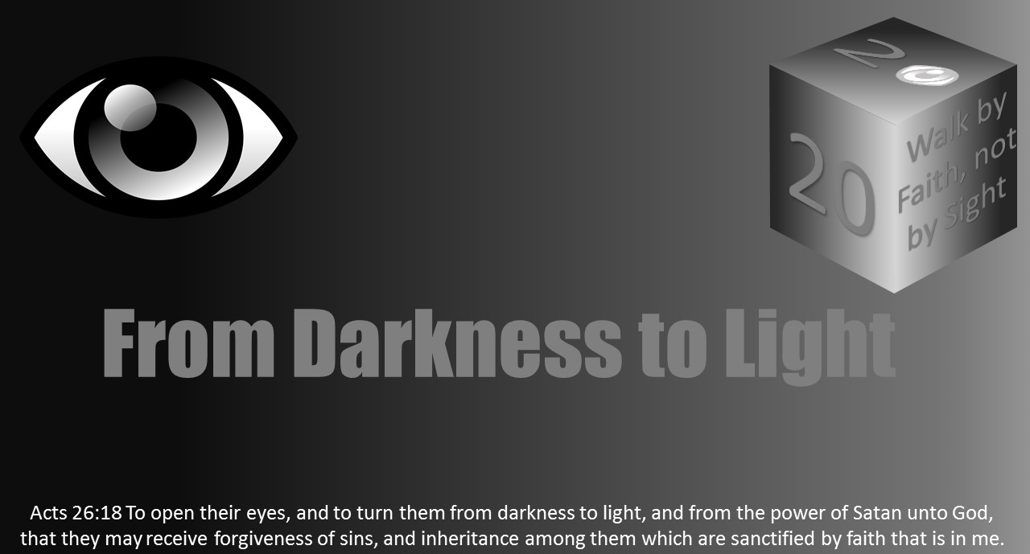


Slide 2

Darkness Lesson 10 The Devil’s Dark Distortions Desperation

Slide 3
Introduction
James in the first four verses of his letter tells us trials will come.
His plea–have the right perspective because trials are used by God to bring us to righteousness.
However, through the rest of his letter, he virtually points to things that are getting in their way, things of the devil.
From inward, sinful enticements to outward struggles to struggles with our own brethren, Satan is constantly at work to turn our perspective away from righteousness-growing trials to desperate attempts that always fall short.

Slide 4
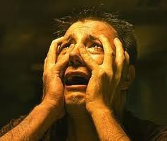
Desperation Defined
One of Satan’s greatest tools is desperation. Desperation is defined as “a loss of hope and surrender to despair; a state of hopelessness leading to rashness.”

Slide 5

Desperation Defined
When thinking about this definition from a Christian mindset, what jumps out as the opposite? The desperate have loss of hope…but we are to be full of hope (Rom 5:1-5).
The desperate surrender to despair…but we are to surrender to the Christ (Jam 4:7).
The desperate have a state of mind and outlook of bleakness, but our eyes are to be set on things above (Col 3:1-4).
The desperate are rash, but we are to be careful how we walk (Eph 5:15-16).

Slide 6
What to Do in Desperation
The question to consider is not if desperation will come, but instead, what to do when one reaches the point of desperation.
What we do or how we see at that moment, in those times, could either be a tool for the devil or strengthening for the Lord.
To illustrate this, I want to briefly consider King Saul and David.

Slide 7
Two Examples at the Crossroads of desperation
We read about David and Saul’s similarities and differences in the book of 1 Samuel.
Both were chosen by God to be king (1 Sam 9; 16);
both showed great ability early on in war (1 Sam 18:7);
both had traits to make them quality kings (1 Sam 9:2; 1 Sam 17).
However, when desperation hit, these men are as opposite as they could be.

Slide 8
TWO Examples at the Crossroads of desperation
After disobeying God with an unlawful sacrifice (1 Sam 13), King Saul starts on a bad path of desperation. T
he spirit of God, which once was in Saul, now has departed, and we also read at different times how Saul was filled with a different spirit (1 Sam 16:14).
Saul was at desperation’s crossroads. Instead of yielding to God’s decision to pass the kingdom to a new lineage, he sets out to find and destroy the one to which God would give the kingdom.
This resulted in more and more bad decisions that continued to lead him away from God.
He became selfish and self-serving in his desperate attempts. Saul would go on to see his desperation the way Satan would have it–dark despair.

Slide 9


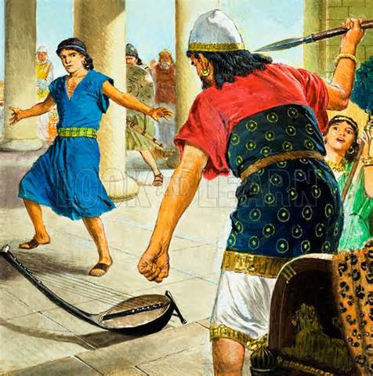
TWO Examples at the Crossroads of desperation
The path of King Saul’s desperation is easy to recognize from our viewpoint:
Made a rash vow (1 Sam 14)
Pushed away God and a godly man–Samuel (1 Sam 15)
Became jealous of one fighting for him (1 Sam 18:6-9)
Tries to kill David twice with a spear though David is helping him (1 Sam 18:10-11)
Seeks to kill David multiple times (1 Sam 18-26)
Turned against his own son (1 Sam 20:30-34)
Turns to a witch instead of God (1 Sam 28)
Ultimately, lost his life and kingdom (1 Sam 31)

Slide 10
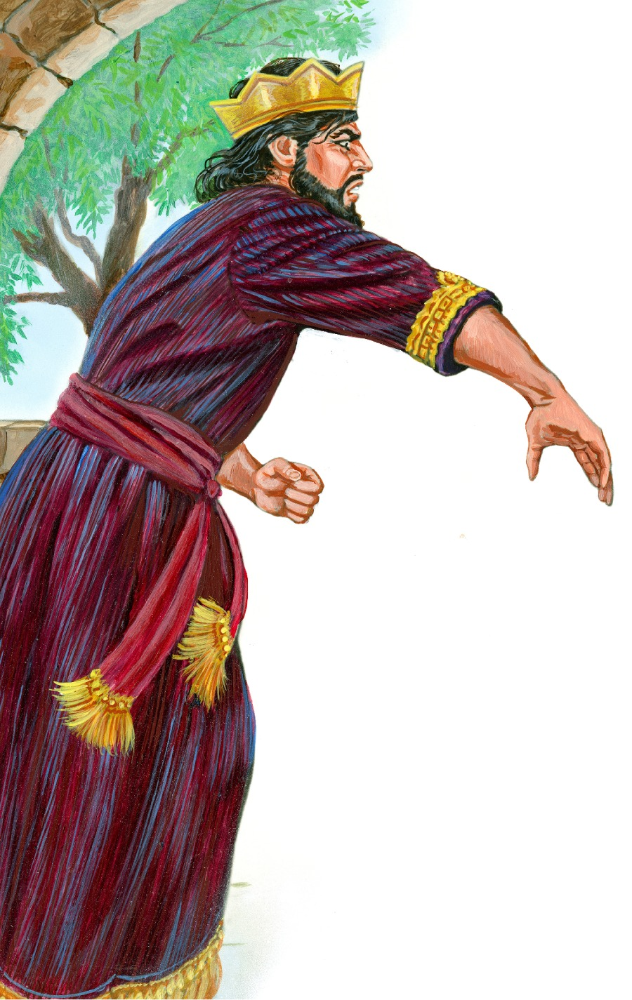
TWO Examples at the Crossroads of desperation
King Saul lost hope,
surrendered not to God but to self-serving pursuits,
made rash decisions without God,
and only ever seemed to have the bleakest of views on life.
Saul chose Satan’s perception at the crossroads of desperation.

Slide 11
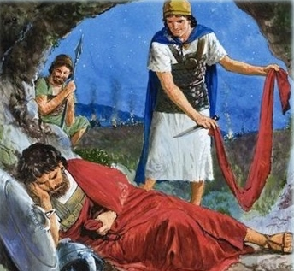
TWO Examples at the Crossroads of desperation
During this time, David would face his own difficult crossroads because of Saul’s wicked desperation. The path of King David’s desperation:
Serving the king faithfully, but was hated by his master
Would have attempts made on his life
Would become a man constantly on the run
Would be forced to hide in caves and amongst the Philistines
Would not commit evil against his foe (1 Sam 24:10)
Trusted in God’s promises and Turned to Samuel (1 Sam 23:2-3)
Had God on his side (1 Sam 18:14)
Would surround himself with loyal, like-minded men (1 Sam 22:1-2)
Would eventually become the greatest king and a man after God’s own heart (Acts 13:21-22)

Slide 12
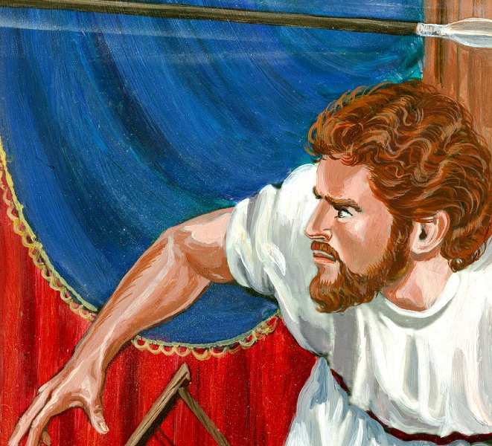
TWO Examples at the Crossroads of desperation
David had plenty of (earthly) reason to lose hope,
to surrender to self-preservation rather than to God,
to make rash decisions without God,
to have only a bleak view of life–but he did not.

Slide 13
Two Examples at the Crossroads of desperation
Two men in similar positions–one saw thru Satan’s perception at the crossroads of desperation, while one saw through God’s.
For both, it depended on through what glasses they were looking.
For us, it is the same way.
James speaks again to Satan’s desired perception versus God’s in James 2:13-18. “For he shall have judgment without mercy, that hath shewed no mercy; and mercy rejoiceth against judgment. What doth it profit, my brethren, though a man say he hath faith, and have not works? can faith save him? If a brother or sister be naked, and destitute of daily food, And one of you say unto them, Depart in peace, be ye warmed and filled; notwithstanding ye give them not those things which are needful to the body; what doth it profit? Even so faith, if it hath not works, is dead, being alone. Yea, a man may say, Thou hast faith, and I have works: shew me thy faith without thy works, and I will shew thee my faith by my works.”

Slide 14
Two Paths on the Crossroads of Desperation
Viewing life with Satan’s desperation yields obvious consequences:
One will learn selfish ambition gets you nowhere.
One will learn short-sightedness happens because of earthly thinking.
One will experience that rashness comes causing disorder and evil actions.
By walking Satan’s path, a person is without patience, hope, and peace. It is full of distorted vision and not sober thinking

Slide 15

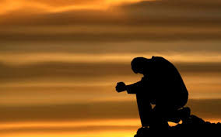
Two Paths on the Crossroads of Desperation
Godly vision at the crossroads of desperation causes us to grow closer to Him in righteousness.
Further, one is strengthened through trials.
This can cause re-evaluation and examination of life. T
his approach should cause one to realize their dependence and confidence in God and His promises.
Godly vision at the crossroads of desperation helps us see clearly that this world is not something we should long for or desire.

Slide 16
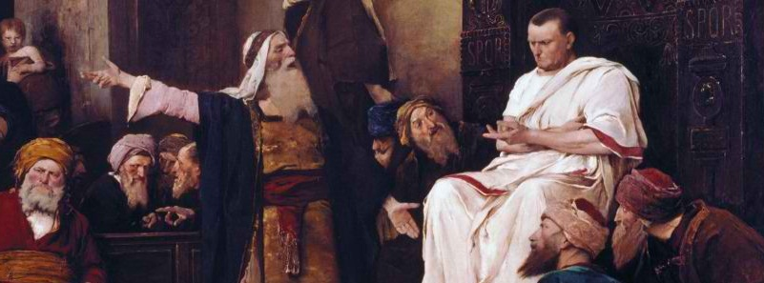
Two Paths on the Crossroads of Desperation
Out of Satan’s and the Jewish leaders’ desperation, we have the cross.
For those same reasons as listed previously, our Savior went to the cross:
Consider the selfish ambition of the Jewish leaders leading to the crucifixion (Jn 11:47-53).
Further, Christ often taught in parable because of short-sightedness (Matt 13:13-15).
In their rashness, the Jewish leaders rushed the trial of the Lord (Matt 26:57-68).
Ultimately, there was no patience, hope, or peace at that moment (Matt 27:24-26).
It is a path full of distorted vision and is the opposite of sober thinking.

Slide 17
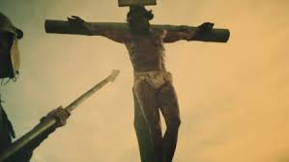
application
We see the same in Acts 7:51-60 as Stephen presents those Jews with the reality that cuts their hearts
their reaction is one out of pure evil desperation
Only thinking this message did not fit what they wanted
they killed the messenger and LOST their opportunity, at least at that moment, to become right with God.
out of evil desperation man has seen fit to do very wicked things
We too have seen fit to do wickedly (Tit 3:3). Living with a view like this, we would certainly have no hope without Christ (Eph 2:1-3).

Slide 18
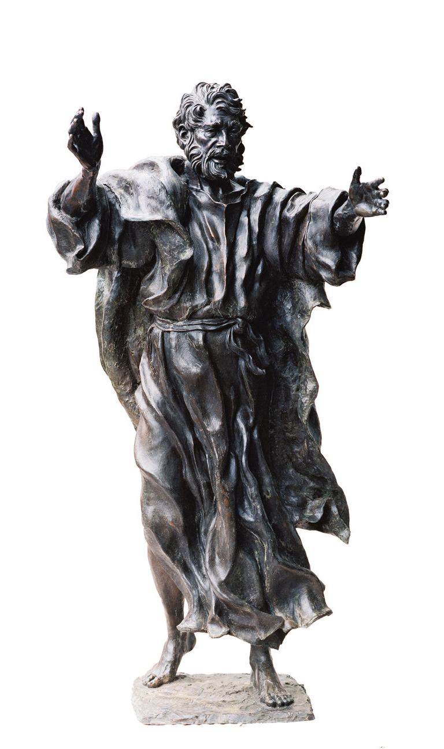
application
After Peter tells the people on Pentecost that they had crucified the Christ, desperation hits them.
In Acts 2:37-42, desperation led to questions, which led to godly answers, which led to obedience. Those who received chose to see through wicked desperation to God!
god’s plan works. Satan’s desperate attempts did not even work for him. Why would we think his way would work for us?

Slide 19

application
Desperation’s crossroads could come at different times and in different ways for different people.
As James points out in chapter 1, the question then is not “if” the devil or difficult trials come but instead to “what” or to “whom” will you turn?
Satan is going to continue to prowl around after us to devour us with things like worldly desperation (1 Pet 5:8).

Slide 20
application
Joshua was told by God, “Have I not commanded you? Be strong and courageous! Do not tremble or be dismayed, for the Lord your God is with you wherever you go” (Josh 1:9)
we are also told the same in 1 Pet 5:6-11.
We can resist the devil by humbling ourselves to God, casting our anxiety on God through prayer, being sober of spirit, being on alert, strengthening our faith, knowing we have the grace of God on our side.
Ultimately, we must realize we are not alone in our struggle. If God is on our side, we do not have to worry about the details of the box score of life.
Instead we can have faith and confidence in His promises that in the end we will be with Him for eternity.
History is full of those who have faced torture and even death with their faith in God. These people are a great cloud of witness not to grow weary or get frozen by fear.

Slide 21
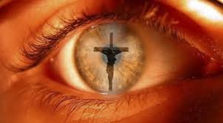

application
We must not let Satan distort our view with worldly despair
We must be strong and courageous through desperate trials in life.
Let our focus be like David, Joshua, and Christ through desperation fixed on God and His plan.

